Slide 1
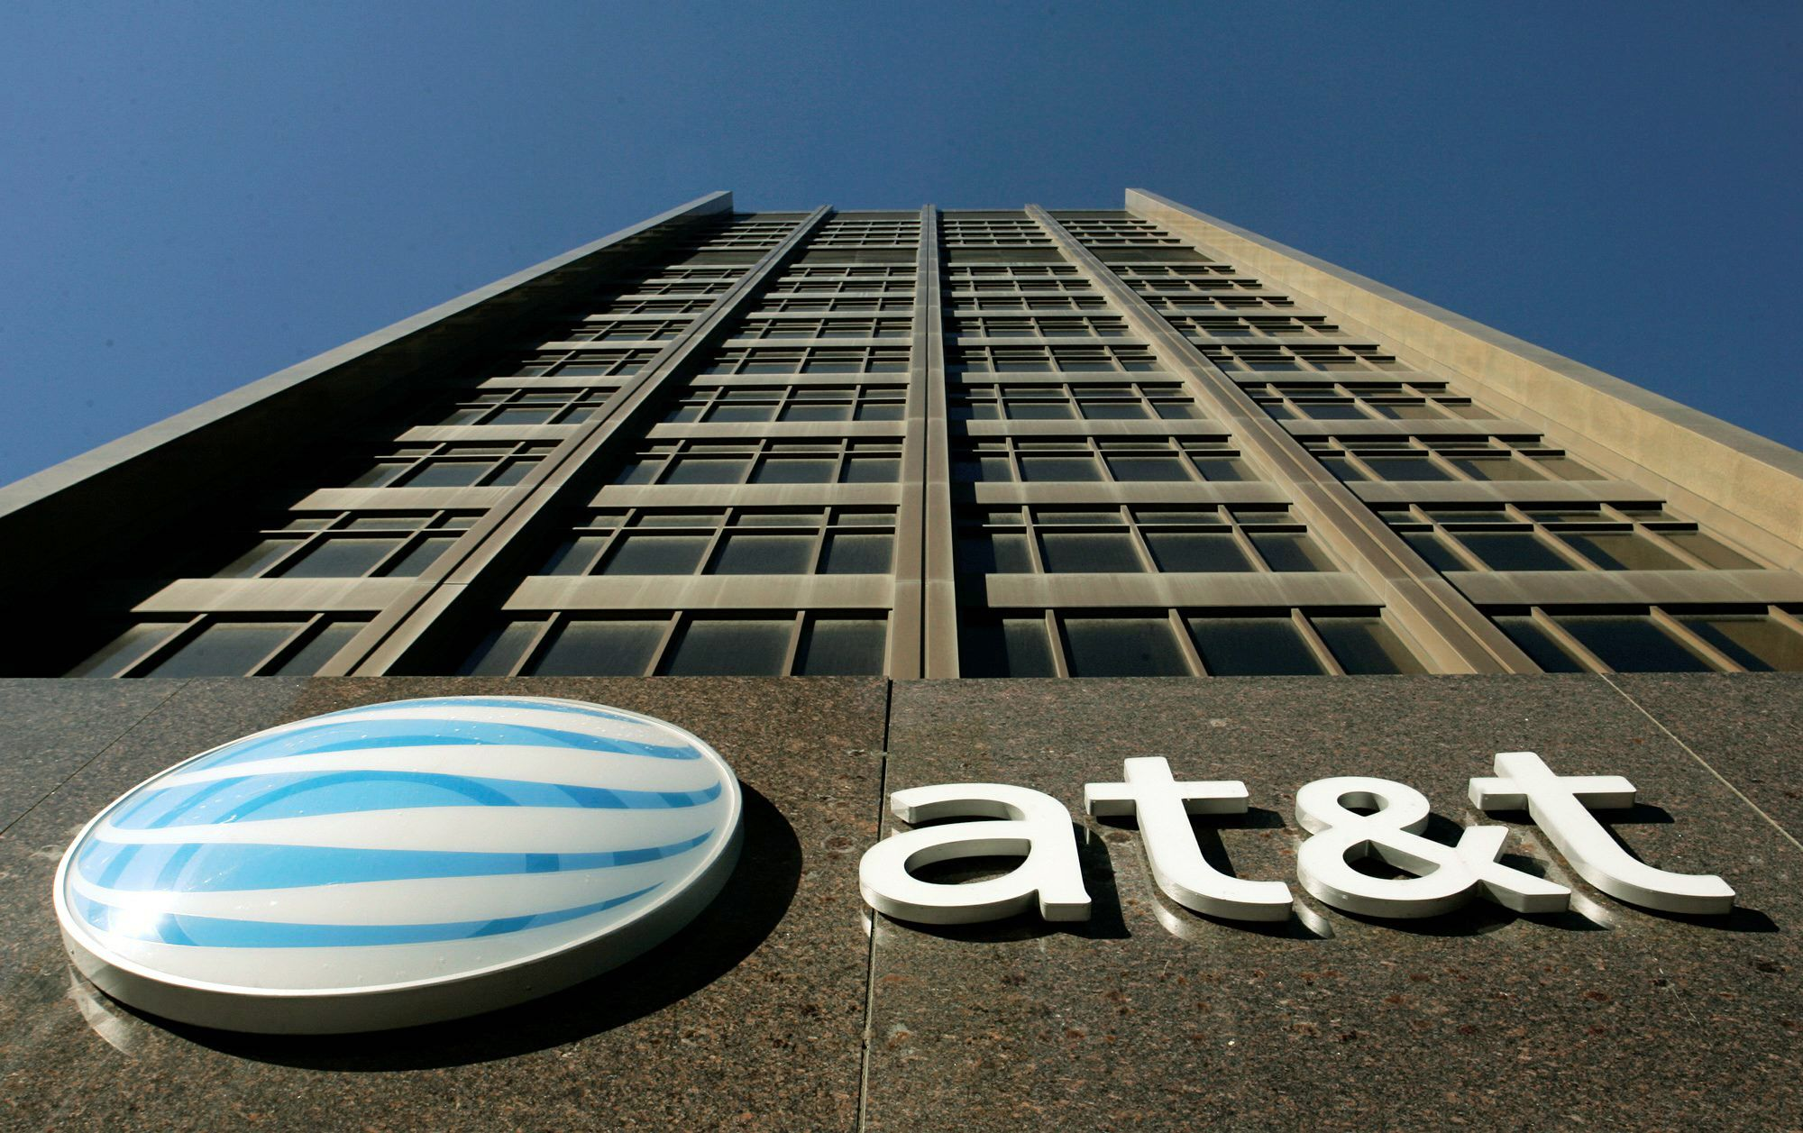

Valuation & Corporate Financing Opportunities

Slide 2


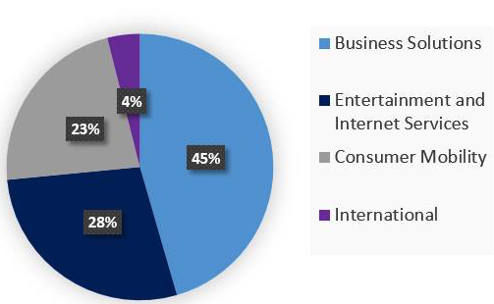
Company Overview
Business Summary
AT&T with its long history, brand power and industry benchmarked performance is a dominant player in the U.S Telecom market. The industry’s constant evolution has led to a decline in the Wireline industry which is amongst AT&T’s core business segments. It's acquisition of DirectTV in 2015 would allow it to leverage the amalgamated expertise to offer its customers high quality products and services thereby driving its growth into the future.
Business Segment’s as of 2015 :
Business Solutions: Conglomeration of wireless and wired networks for provision of complete communication solution.
Entertainment & Internet Services : Targeted at provision of high-speed internet, video and voice services.
Consumer Mobility: Voice & Date services for consumers and wholesalers.
International : Entertainment and wireless business in Latin America & Mexico
Present Situation → Currently faced with Increasing competition from all fronts, from cost cutting, spectrum wars to continual innovation by competitors.
Journey to 2020 → Establish a Market leadership position by increasing connectivity through M&A, cost synergies via amalgamation of cross-business expertise and scale economies.
Business Segments by Revenue – 2015 Onwards
Key Statistics (as of 1st Nov 2015)
Financial Summary (Q3 2015)
P/E Ratio | 13.27
Share Price ($) | 33.21
Recent Dividend ($/share) | 0.47
Dividend Yield | 1.41%
Total Revenue LTM (in millions) | $139,121
Market Capitalization (in millions) | $204,275
Nine Months Ended Sep. 30 | 2014 | 2015
Net Income: | $10,654 | $9,601
Cash from Operating Activities: | $25,594 | $26,695
Time Interest Earned: | 29.14 | 29.37
Debt-to-Equity | 0.84 | 0.97
Notes:
Business Solutions
Entertainement & Internet Services
Consumer Mobility
International

Slide 3
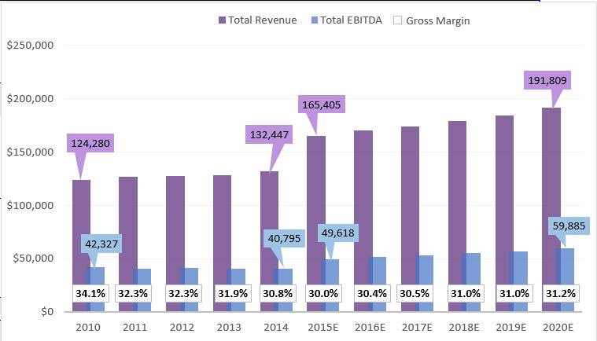
Company Overview
Revenues – Historical & Pro-forma
Notes:
Business Solutions
Entertainement & Internet Services
Consumer Mobility
International

Slide 4
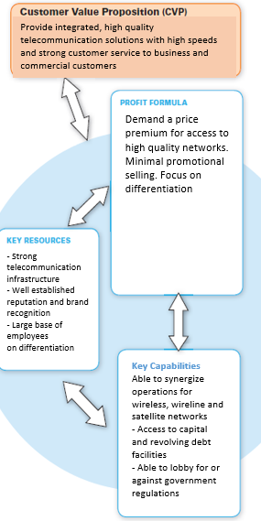
Business Model & Operating Analysis
CORE COMPETENCY: Ability to provide massive economies of scale to provide high quality telecommunication connectivity.
Metric | Wireless | Wireline | Int’l | DirectTV
Churn
Net Additions
ARPU
Another One
Notes:
What is the value proposition?
What are the target markets?
Who are the critical members of the team?
Where does competitive advantage exist?
Why is there a competitive advantage?
When will development, launch and cash flow breakeven occur?
CHURN
NEW SUBSCRIBERS
Acquisitiion of DIRECTV has provided access to an already established market.
Through amalgamation of experience of expertise of different business units, AT&T is expected to provide higher value for customers thereby giving its business segments a boost.

Slide 5
Business Model & Operating Analysis
Business Model & Operating Analysis
Key Resources : Strong telecommunication infrastructure, well established brand with over a decade of history & cross-segment employee skill base.
Key Capabilities : Ability to synergize operations between its wireless, wire-line and satellite networks, with access to capital at competitively low industry rates.
AT&T’s value proposition is based on providing integrated, high quality telecommunication solutions with high speeds and strong customer service to its multitude of customers by leveraging its mulit-faceted industry experience and innovation
Profit Formula : Charging a price premium for access to high quality, high speed networks with a focus on differentiation.
Core Competence : Leveraging its Economies of Scale to provide high quality connectivity solutions to its massive customer base.
AT&T’s business model has transformed with the acquisition of DirecTV whose increasing revenue and customer base would give AT&T a buffer from declining market share in its Wireless and Wire-line segments.
Notes:
Total Subscribers (Wireless, Wireline, DTV)
ARPU
T- Mobbile, Verizon, AT&T

Slide 6
Business Model & Operating Analysis
Business Model and Operations Analysis
EBITDA service margin has been on a steady decline for the past decade but AT&T has turned it around since 2010 with increased penetration of their NEXT plan which basically gives you several discounts on fees if you upgrade your wireless phone with AT&T. This is an attractive strategy for retaining subscribers while minimize churn rate, aligning well with AT&T’s core strategy and competencies.
Equipment revenues are increasing but are not reaching their potential which is attributable to lucrative deals being offered by no-contract service providers such as T-Mobile. However, it is not realistic for AT&T to adjust their pricing strategy to try to compete through these means to make up for lost equipment revenue market share as it is a small percentage of their overall revenue.
AT&T’s Churn rate has been increasing relative to the industry which is attributed to its declining revenues and subsequent declining market share in its wireless segment. . (grab numbers/graph from Bloomberg)
Notes:
What is the value proposition?
What are the target markets?
Who are the critical members of the team?
Where does competitive advantage exist?
Why is there a competitive advantage?
When will development, launch and cash flow breakeven occur?
CHURN
NEW SUBSCRIBERS
Acquisitiion of DIRECTV has provided access to an already established market.
Through amalgamation of experience of expertise of different business units, AT&T is expected to provide higher value for customers thereby giving its business segments a boost.

Slide 7
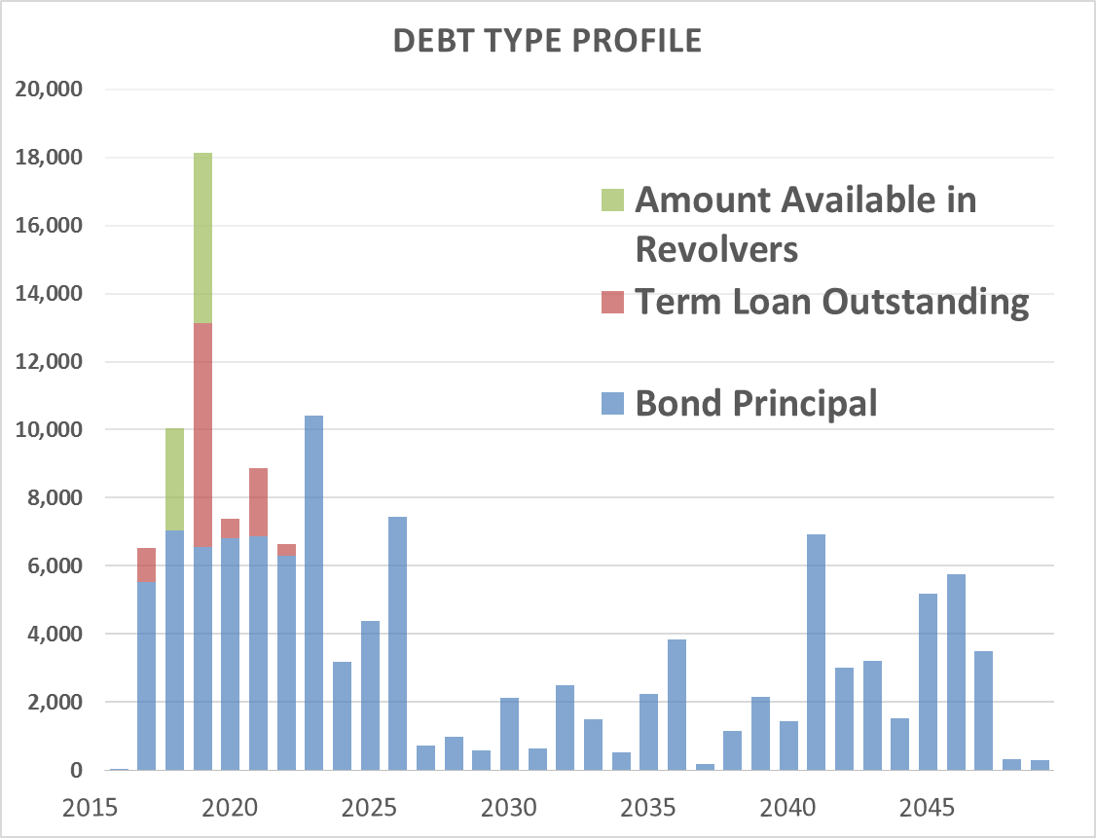
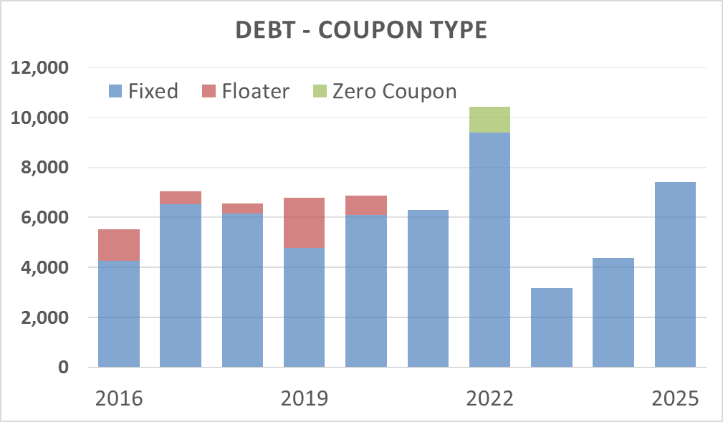
Liquidity & Debt Capacity
DirecTV
$49 billion dollar acquisition
Assumed $19B in long term debt.
Debt-to-Equity
Rising in the short term
Still below 100 at 87.6% but industry is trending higher.
Interest Coverage
Interest Expense of $3.6B
Able to pay off interest 11.29x’s with EBITIDA (2014)
Revolving Debt Facility
5%
Available but not used
$10B total available line of credit
6.2x interest coverage (EBIT)
Current Debt Type Profile
Ratio | Value
Current | 0.86
Quick | 0.62
Cash | 0.23
Agency | Rating
Moody | Baa1
S&P | BBB+
Fitch | A-

Slide 8
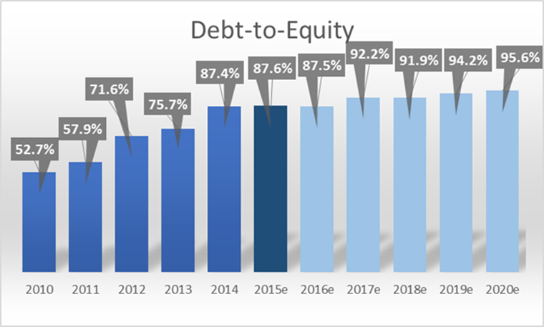
Liquidity & Debt Capacity

Slide 9
Shareholder Ownership
C suite management has accumulated $40m in stock → continuing to buy shares
Total insider shares held: 2.95 million (0.04797%)
Number of transactions for share purchases heavily outweigh the number of transactions for shares sold by insiders in the LTM
However, in terms of shares sold, purchased shares are far outweighed by the shares sold
Institutional Summary
Shares Outstanding | 50.84
% of Float Held | 50.89
Short Interest (in millions) | 113.8
Short Interest as a % of Float | 1.85
Days to Cover Shorts | 89.9
Ownership (Institutional) | 54.87%
Ownership (Non-Institutional) | 45.13%
Geographic Ownership (%)
US | 84.06
Great Britain (UK) | 4.2
Canada | 2.16
Japan | 1.56
Switzerland | 1.64
Sweden | 1.29
Norway | 1.11
Netherlands | 0.92
Germany | 1.18

Slide 10
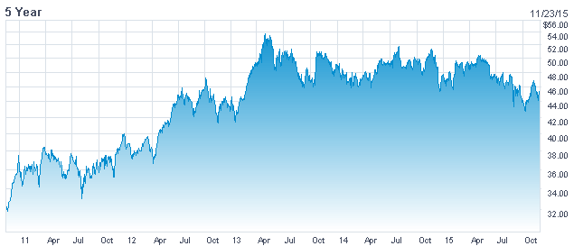
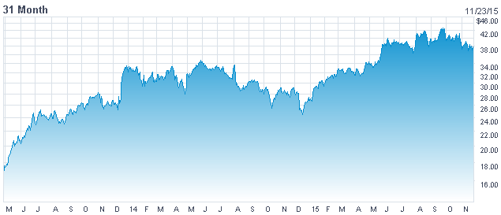
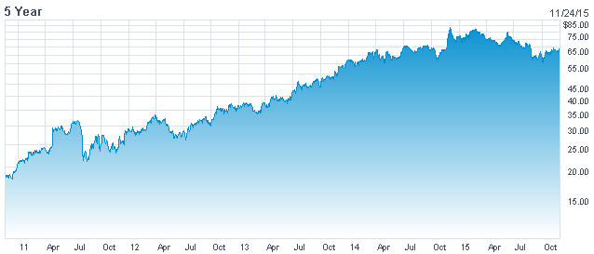
Competitors
Integrated
Wireless
Television
Verizon is AT&T’s main wireless competitor
Similar scale and operational structure to AT&T
High reliability and best coverage of US in the entire industry
Media and Broadband Segments are in direct competition with AT&T having more HD channels and fastest internet speeds
Best technological infrastructure
Take on a great amount of debt as there are network capacity constraints
3rd largest wireless retailer
Has aggressively been capturing customers from Verizon and AT&T by pursuing price cutting strategies
Customer base growth due to very competitive pricing strategies in addition to effective marketing campaigns
Provide unlimited data plans but are hindered by limited coverage and poorer quality network
Focus shifts to maintaining customer loyalty after they have made the switch from competitors
Verizon
T-Mobile
Dish
Dish is DirecTV’s primary satellite TV competitor
Offer competitive pricing in order to capture market share and increase subscriber base
Have a strong Latin America presence and have a very similar business structure compared to DirecTV
Target rural residents in the US to consumers who aren’t served by wireline broadband
Aim to continue acquiring more spectrum in their long term plan is one of their core competencies
P/E Ratio | 12.10
Share Price ($) | 46.17
Recent Dividend ($/share) | 2.26
Dividend Yield | 4.94%
Total Revenue LTM (millions) | $130,558
Market Capitalization (millions) | 187,860
P/E Ratio | 44.20
Share Price ($) | 41.38
Recent Dividend ($/share) | 0
Dividend Yield | 0.00%
Total Revenue LTM (millions) | $ 31,960
Market Capitalization (millions) | $ 33,768
P/E Ratio | 24.90
Share Price ($) | 61.86
Recent Dividend ($/share) | 0
Dividend Yield | 0.00%
Total Revenue LTM (millions) | $ 6,525
Market Capitalization (millions) | $ 28,653

Slide 11
VALUATION

Slide 12
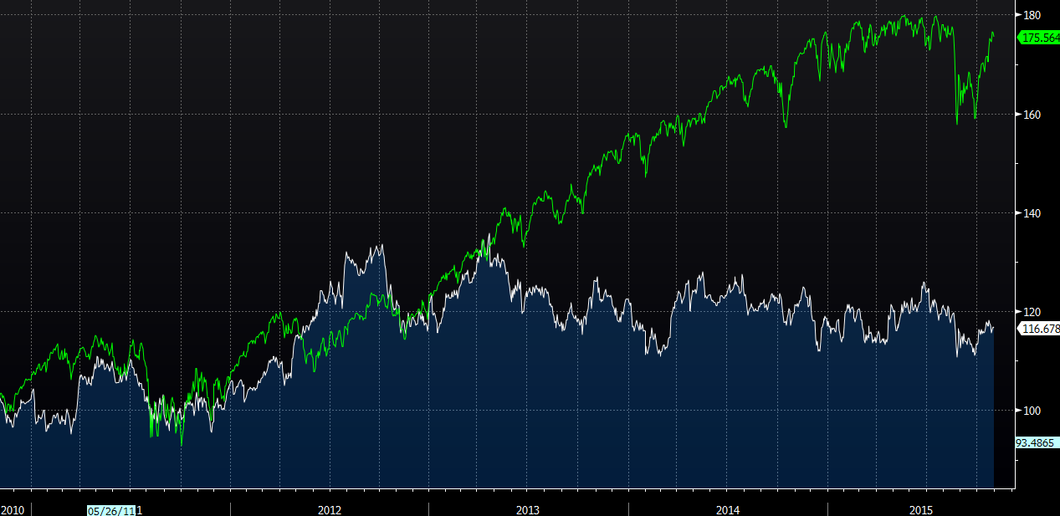
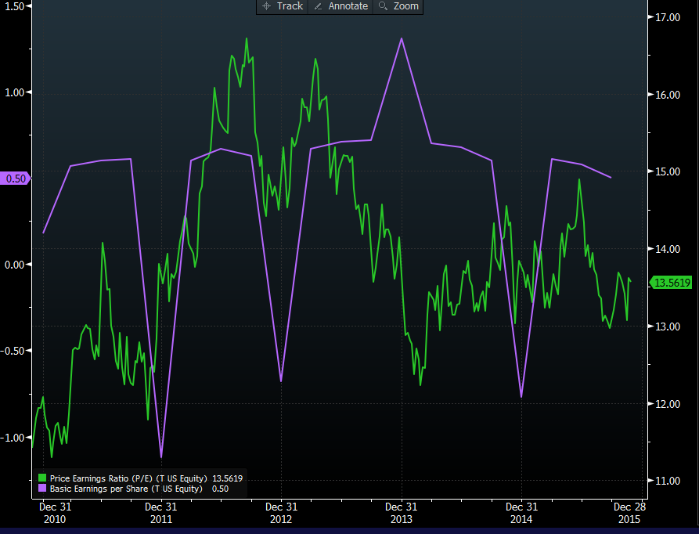
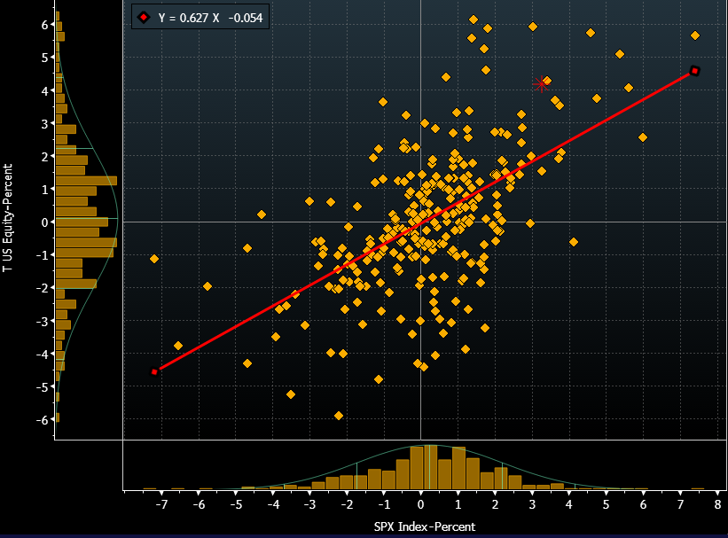

Historical Share Price Performance
S&P 500
Key Points:
- AT&T share price has been lagging the market significantly.
- Has been trading in a sideways pattern for the past 3 to 4 years.
- Hit it’s all-time high in the beginning of Q4 2012
39.00
27.33
33.51
T Price/Earnings Ratio
T Earnings Per Share
T Actual Return VS SP&500

Slide 13
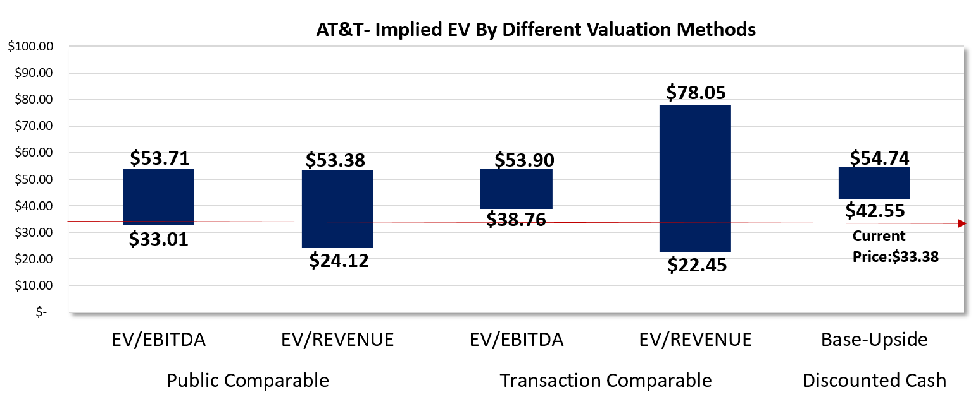
Valuation Overview (Football Field)
AT&T – Implied EV by Different Valuation Methods
The DCF upside case of $54.74 and base case of $42.55 is in line with comparable and transactional data when comp

Slide 14
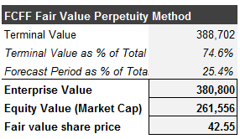
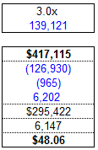
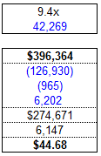




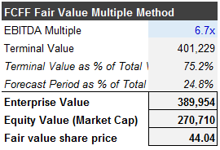
Valuation Analysis
DCF
Precedents
Comps
EV/Rev
EV/EBITDA
EV/Rev
EV/EBITDA
EV/Rev
EV/EBITDA
SEGMENTED
We can see through the precedent model that the current M&A environment is indicating a price premium that is moderate.
COMBINED ENTITIY
Using a segmented comparable model we get a lower valuation then the combined entity, indicating that integrated players command a stronger valuation.
Both DCF valuation methods point to a fair value share price higher than the current share price of $33.51 per share.

Slide 15
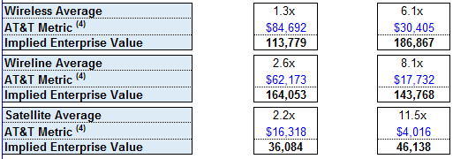
Comparables Overview
Segmented
Combined Entity
EV/Rev
EV/EBITDA
EV/Rev
EV/EBITDA
2.3x
6.4x
Verizon
2.3x
6.4x
Verizon
2.3x
6.4x
Telus
2.3x
6.4x
Telus
2.3x
6.4x
BCE INC.
2.3x
6.4x
BCE INC.
2.3x
6.4x
T-Mobile
2.3x
6.4x
T-Mobile
2.3x
6.4x
Sprint
2.3x
6.4x
Sprint
2.3x
6.4x
US Cellular
2.3x
6.4x
US Cellular
2.3x
6.4x
CenturyLink Inc.
2.3x
6.4x
CenturyLink Inc.
2.3x
6.4x
Comcast
2.3x
6.4x
Comcast
2.3x
6.4x
Time Warner
2.3x
6.4x
Time Warner
2.3x
6.4x
Dish

Slide 16
Precedent Transaction Overview
EV/EBITDA (LTM)
FAIR VALUE PRICE: $46.03 using 9.6x Combined Entity Average
Virgin Media
Direct TV
Qwest Communications
Hughes Communications
Columbus Communications
Tele Norte Lesta Participacoes
NBC Universal Media
Acquisition
Moderate Valuation
Acquisition
Acquisition
Low Valuation
Moderate Valuation
Acquisition
Moderate Valuation
Acquisition
Moderate Valuation
Acquisition
Low Valuation
Acquisition
Moderate Valuation
9.0x
Criteria for Using Transaction
- Large-scale transaction with a substantial merge of assets and company cultures
- Has an identifiable characteristic with one of AT&T’s operating business segments
- EV/EBITDA levels that are not excessively high
5.5x
7.6x
9.0x
12.6x
3.5x
9.3x

Slide 17
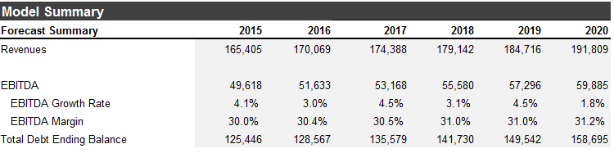
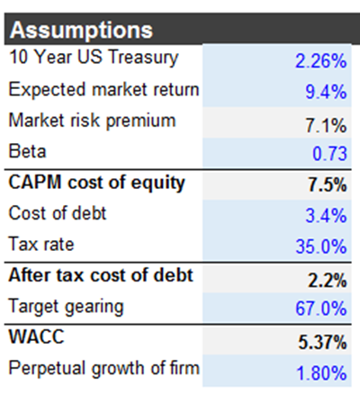
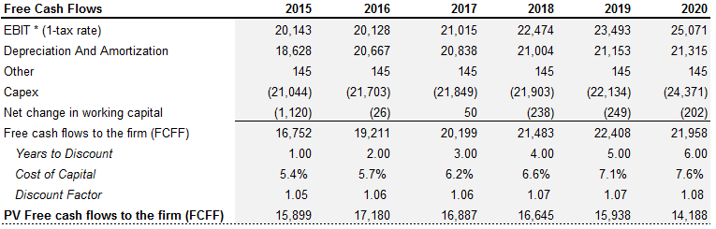
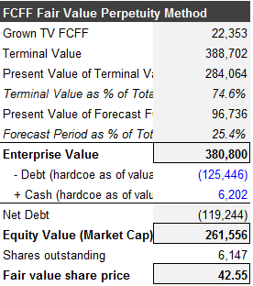

DCF Overview

Slide 18
LEVERED FINANCE ASSUMPTIONS, IMPACT AND AFFORDABILITY

Slide 19
LEVERED FINANCE ASSUMPTIONS
$20 Billion dollar acquisition
Funded with 67% debt and 33% equity
Year
Interest Rate
2.2%
3.0%
2.5%
3.1%
3.6%
Principal Payment ($b)
2800
2800
2800
1500
1500
2016
2017
2018
2019
2020
Goal: Align with their target gearing ratio when looking ahead at future financial capacity
Constraints when investing over $10B
- Restrained ability to meet management’s target of a 70% dividend payout ratio
-T’s credit rating would be downgraded, affecting future borrowing ability
- Decreased marketability of a seasoned offering.
Federal Reserve expected to be very gradual with interest rate increases
Initially higher principal payments to keep Net Debt/Equity levels within target range
Rates rise → lose more subscribers than anticipated → debt problem

Slide 20
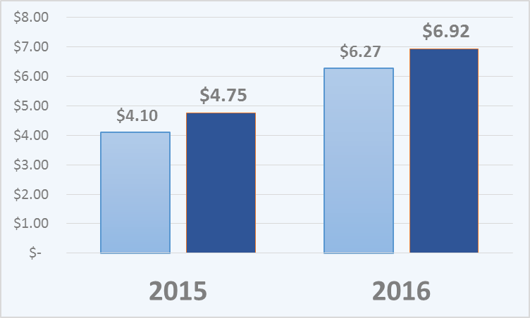

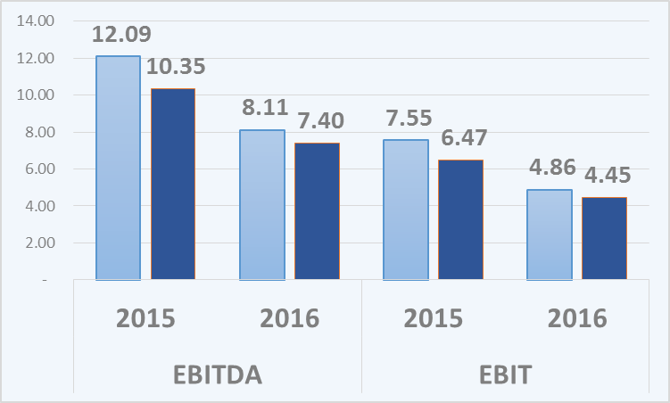
LEVERED FINANCE IMPACT AND AFFORDABILITY
Interest Expense
1-Year Default Probability
From 0.042% to 0.048%
Acquisition in $2-7B range is reasonable to avoid running into high level of debt constrains
Interest Coverage
$20B financing available but we advise management to be cautious not to inflate already substantial debt levels
Making a purchase at current interest rates, borrowing and paying back healthy principal payments in the first 2/3 years, before expected interest rates begin to rise is optimal

Slide 21
STRATEGIC TRANSACTIONS

Slide 22
Strategic Overview
Company Requirements
Successfully integrate DirecTV into the AT&T business model
Design and create a global network service platform to reallocate human capital
Continue to perform as a market leader
Company Goals
Financial | Operational | Strategic
Lower Debt-to-Equity (long term target of 80-85%) | Effective Cost Control Systems | Focus on customer profitability (ARPU)
Find revenue growth amongst saturated markets | Merge company cultures appropriately | Disengagement from aggressive promotional strategies
Divided Payout of 70% | Exposure to new consumer habits such as streaming services | International market penetration
Opportunities
Softening ties between USA & Latin America
Cross-selling capabilities between existing segments and DirectTV
Ability to lock into historically low interest rates
T’s operational expertise needs to be utilized and the economies of scale that results from the deal need to be fully leveraged
Strive to balance their debt levels over the medium term but continue to expand in capital expansion projects and take on debt in the short term
Pursue muli-tiered expansion strategy to ensure its dominance both domestically and internationally in the long term

Slide 23
Transaction Recommendations
Favorable Conditions for Transactions
 | International Expansion | Telecom Consolidation | Hardware and Value Chain Inputs
Company | - Strong ARPU - Low P/E - Growing subscriber base | - Alignment with AT&T's core business model - high quality capacity - Competitive history with AT&T | - Ability to costs - Ability to use targets technology and IT infrastructure
Industry | - National telecom program deregulation worldwide & globalization | - High spectrum supply, leading to low prices - Softening government regulations. | - Future expected improvements in technology which would improve margins
International Expansion
Telecom Consolidation
Hardware and Value Chain Inputs
→ Large underdeveloped markets are expected to have increase amounts of mobile data consumption as urbanization takes place. There is a high demand and lack of supply especially in countries like Cuba. Relaxation in foreign telecom policy restraints on American competitors by Latin American governments.
→ Leverage existing capabilities and core competencies to further increase cost synergies with new users. Use increased buying power to negotiate transactions that favorably expand AT&T’s user base. Focus on acquisitions that will be able to provide bulk wireless subscribers and other users quickly.
→ To obtain a competitive advantage over cost structure and to ensure continuous availability and successive innovations of product offerings. Hardware equipment revenues are increasing faster than service revenues at AT&T and acquisitions in the hardware space will allow it to cut costs and increase EBITDA margins. Service quality and network coverage would see positive benefits.

Slide 24
Rank #1
Transaction #1 – International Expansion
T’s ability to enter foreign markets through acquisitions allows them to bring best practices and world class quality to help operations and margins improve in countries where telecommunications operations are underdeveloped and underutilized.
Internet and telecommunication service in the global market is expected to increase worldwide as world population increases and society becomes more and more connected.
Countries adjacent to the US will provide ample opportunity for further expansion especially with foreign governments becoming more accepting of foreign investment through less stringent regulations. With AT&T’s recent acquisitions, it makes sense to continue on the same path for long-term success in international markets.
Enter Cuba through stake in ETECSA
The Obama administration’s liberalization of trade policy with Cuba is starting to spur foreign investment in Cuba’s economy, with Verizon & Sprint already making inroads. More then 3 million visitors are expected in Cuba next year, which is expected to increase to 5m as facilities are developed . Although the national Cuban telecom company, Empresa de Telecomunicaciones del Cuba, S. A. (ETECSA )is established as a private joint venture is closely regulated by the Ministry of Telecommunication, it is favorable for AT&T to acquire a piece of the Cuban Telecom industry in
the long run. Cuba’s telecom infrastructure is outdated and limited in scope, creating an opportunity for investment and AT&T can capture a portion of Cuba’s telecom sector via ETECSA. Telecom infrastructure development is a long term goal, the short term move would be to give the Cuban population telecommunications solutions through the use of satellites which would subsequently spur demand for wireless, wireline and DirectTV in the country.
+’s
Low Competition (Monopoly)
Underutilized Market
Opportunity for Infrastructure Development
Expand Customer Base
Gradually acquire Axtel
Axtel, a formidable Mexican telecom company, would be a beneficial acquisition target in terms of increasing AT&T’s coverage of data transmission and telecom. services in Mexico as they have a rapidly growing middle class and underserved LTE smartphone market. We recommend that AT&T begins acquiring smaller stakes in Axtel over a 5-10 year time frame to slowly build reputation in a market we have a favourable outlook on. They also have very high profit margins yielding a strong base for AT&T to work with. The recent
acquisition of Mexican wireless provider Iusacell provides significant
coverage of over 120 million citizens. Expanding and enhancing these
networks would be a top tier priority which is why continued
expansion of network infrastrucutre is vital.
+’s
Data Coverage
Underserved Market
Build on Strategy
Expand Customer Base

Slide 25
Rank #2
Transaction #2 – Telecom Consolidation
T’s dominant market leader position in telecom has been sustained through acquisitions and this strategy should continue in the future.
A large portion of the company’s competitive advantage comes from the high quality service and network coverage. Further market consolidation in users will prevent AT&T from becoming stagnant and vulnerable to losing its market leader position.
Churn, especially the customer’s lost to T-Mobile's aggressive price cutting strategy, should be offset by new users gained in acquisitions.
The rigid pricing and persistence for high margins ensures that the company can continue to excel with high ARPU.
Example# 1: US Cellular Corp (USM)
Purchasing US Cellular will allow AT&T to use their size and scale advantages to increase the profitability of the acquired operations. AT&T can also potentially command stronger price premiums by bringing US Cellular customers over to higher quality product and service offerings that US Cellular was unable to provide. US Cellular is a 100% pure play on US domestic wireless telephone service revenues and AT&T and should buy them to rapidly acquire new wireless subscriber revenue. USM’s last 3 quarters have substantially beat earnings per share estimates. The 3.5B market cap implies that the company is within the $2-7B acquisition range recommended. A US Cellular takeover would bring over 4,760,000 active wireless subscribers to AT&T’s wireless subscriber base (120m). This multiplied by AT&T’s monthly ARPU 51.15 gives a new revenue stream of $243.47m per month.
This transaction would be smaller then the failed attempt by Verizon to acquire T-Mobile and because of the small market position of US Cellular, we except a better reception from regulatory authorities. AT&T should look to US Cellular to consolidate it’s telecom base because it is still a substantial quick addition of net users but it is not large enough raise any serious regulatory red flags.
Acquiring US Cellular Corp would not be a complex process for AT&T . They would easily be able to amalgamate users with their own networks and push new AT&T offerings, notably DirectTV, through bundling and promotional programs. This quick addition to their user base will help offset currently declining wireless revenues and open up lucrative cross-selling channels.
+’s
Established name
Growth potential
Opportunity for cost cutting
Similar capital structure

Slide 26
Rank #3
Transaction #3 – Vertical Integration
This transaction would work in tandem with the Cuban expansion to help AT&T provide Cubans with connectivity solutions.
T’s could look to vertically integrate their business model, especially in their new satellite TV service area where the new larger, conglomerated AT&T company can pursue acquisition projects that weren’t feasible under the stand alone DirecTV.
Right now AT&T can only achieve better satellite hardware infrastructure and service quality by negotiating with suppliers. If they acquire a satellite hardware company, they can gain control in the pace of technological innovation they can purse their own research and development.
Example# 1: EchoStar Satellite Services
This acquisition will be beneficial in terms of getting the satellite TV product offering up to the highest quality standard possible and it will further promote AT&T as an integrated player with strong quality standards. As a secondary advantage, EchoStar is a very large supplier to Dish, and therefore if AT&T buys the company, Dish’s supply chain management system will be temporarily disrupted rendering an opportunity to expand market share. Backward integration into EchoStar’s
established operations will allow AT&T to acquire the latest
technological advancements from EchoStar. Moreover, we will
be able to integrate their core business segment of distributing
of satellite receivers and set-top boxes into our Cuba strategy
as the country currently lacks suitable infrastructure to utilize,
therefore improving both speed and connectivity will be vital.
+’s
Supplier to Competitor
Increasing
EBITDA
Margin
R&D Assets
Decreasing D/E
Example# 2: Via Sat Inc.
This provider of satellite communications products like modems, terminals, network control systems and information distribution systems will help AT&T as it competes in the satellite TV arena. Further building upon AT&T’s infrastructure with an acquisition of a company with a market cap of just under
3 billion would be a solid step to achieving greater vertical
integration and cost synergies through communication
equipment. Fixed and mobile broadband business services
are expected to see strong growth in consumer demand
both regionally and worldwide over the upcoming years.
Benefits include acquiring a blue-chip customer base and
a cost-efficient business model, maintaining a balance
between expenditure on new product and service
development with efficient management of capital.
+’s
Aligned Strategy
Optimal Growth Prospects
Efficient R&D
Minimal Debt Impact

Slide 27
Additional Transactions
Content Producer
Canadian Expansion
AT&T could look to enter the content creation side of the media business and begin to acquire television studios and film business in order to improve their components of the value chain.
AT&T could investigate entering into the Canadian wireless market as regulations are evaluated by the new Liberal government.
Feasibility to purchase a 8-10% in Viacom in order to get a seat at the table in the content generation business and start to meld AT&T’s business process with the content generating arm of the business.
AT&T’s core competency revolves around their telecommunication assets, especially when it comes to broad high quality networks and they would be venturing into a very competitive space with many large players including Disney and Netflix.
Acquiring a smaller cable or satellite company, such as Shaw Communications, would boost AT&T’s subscriber base and open up cross selling synergies with DirecTV

Slide 28
Conclusion
Successfully integrate DirecTV into the AT&T business model
Design and create a global network service platform that maximizes automation to reallocate human capital to more complex and creative tasks.
Continue to perform as a market leader
Company Goals

Slide 29





Appendix 1 : Team Overview
Mr. Martin has a background in capital project planning/scheduling and project controls working on multibillion dollar projects. He has created schedules for business development corporate finance teams and is looking to transition into the corporate finance and investment banking side of project work.

Slide 30
Appendix II : Model Output
Notes:
Insert all Model Output Slides.

Slide 31

Discounted Cashflow Model
Notes:
Insert all Model Output Slides.

Slide 32
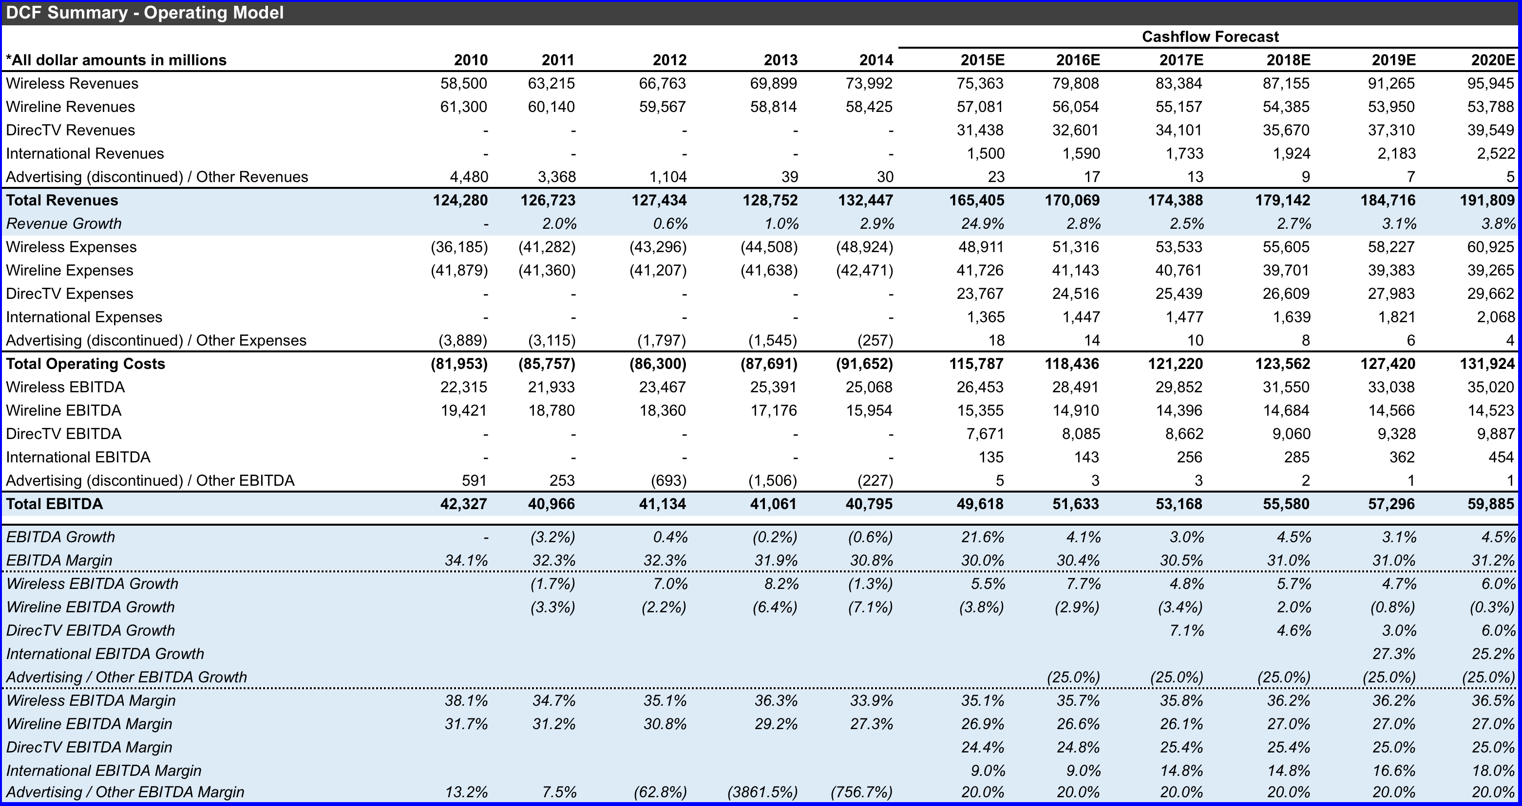
Notes:
DCF Summary – Operating Model

Slide 33
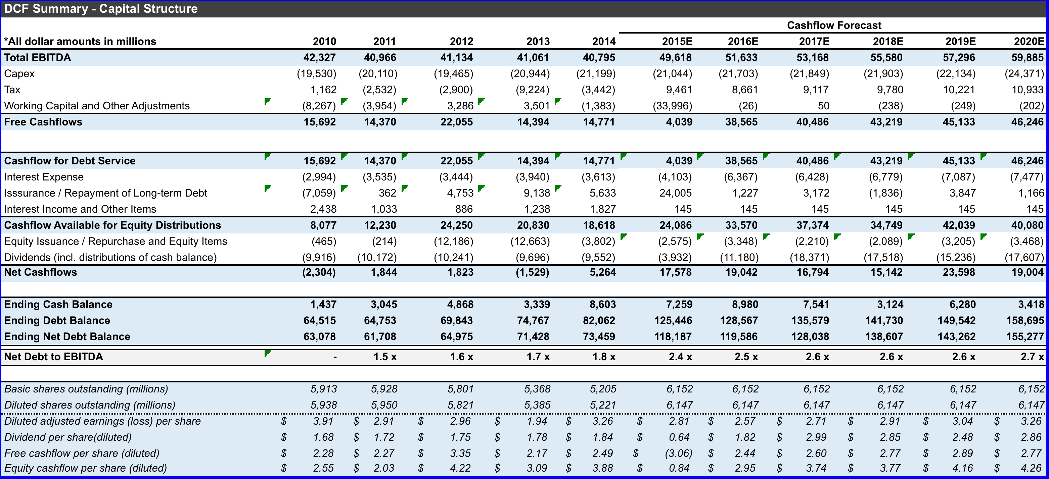
Notes:
DCF Summary – Capital Structure

Slide 34
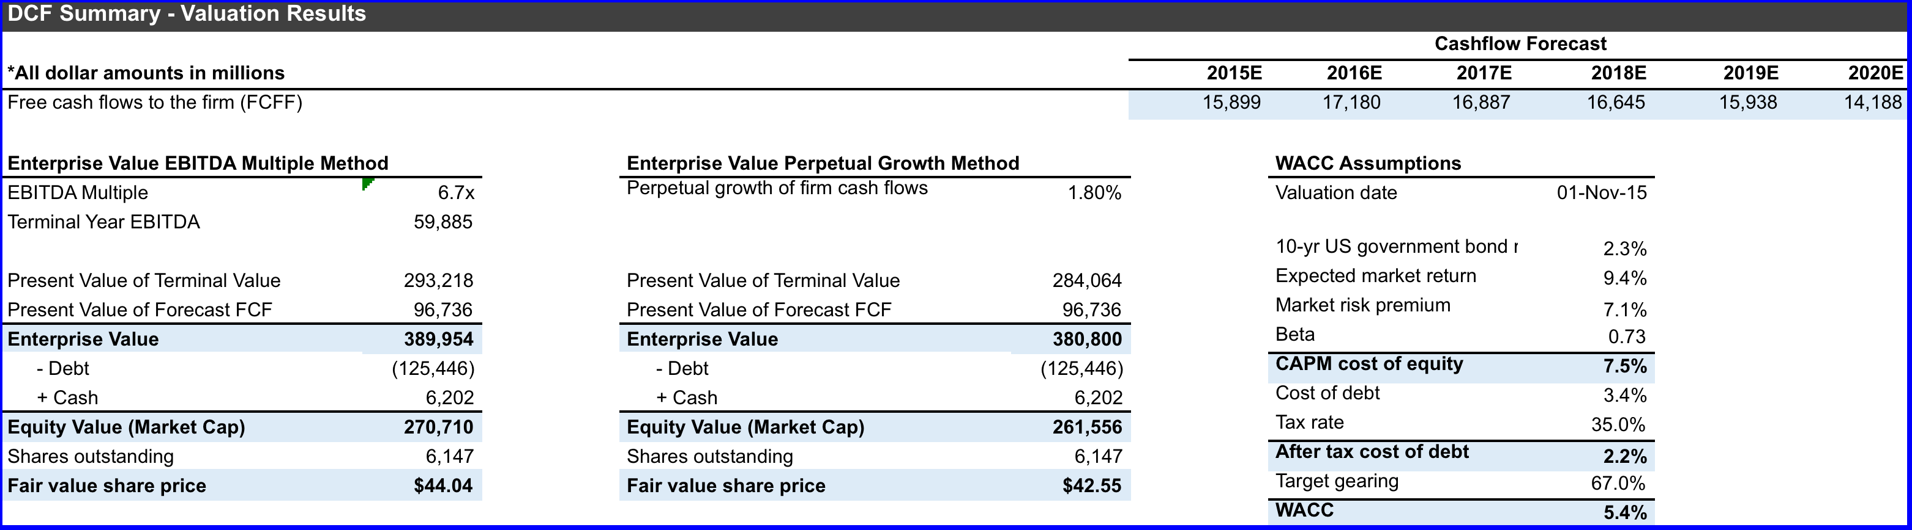
Notes:
DCF - Valuation

Slide 35
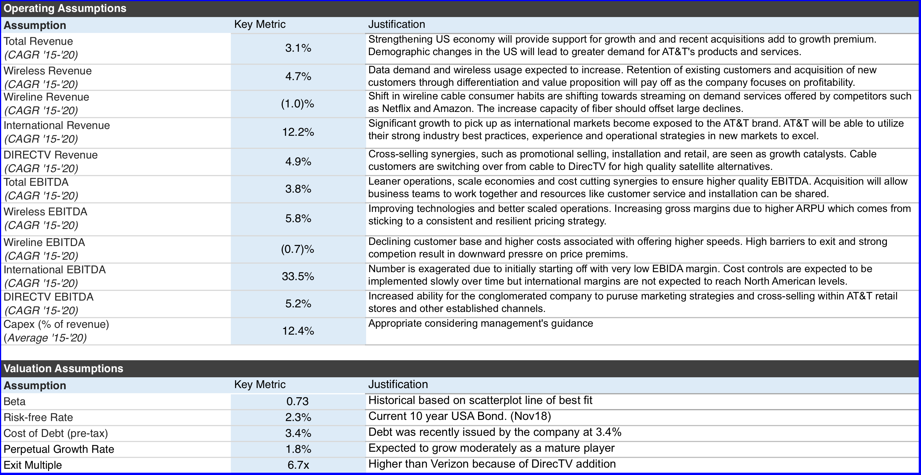
Notes:
DCF – Operating Assumptions

Slide 36
Leveraged Finance
Notes:
Insert all Model Output Slides.

Slide 37
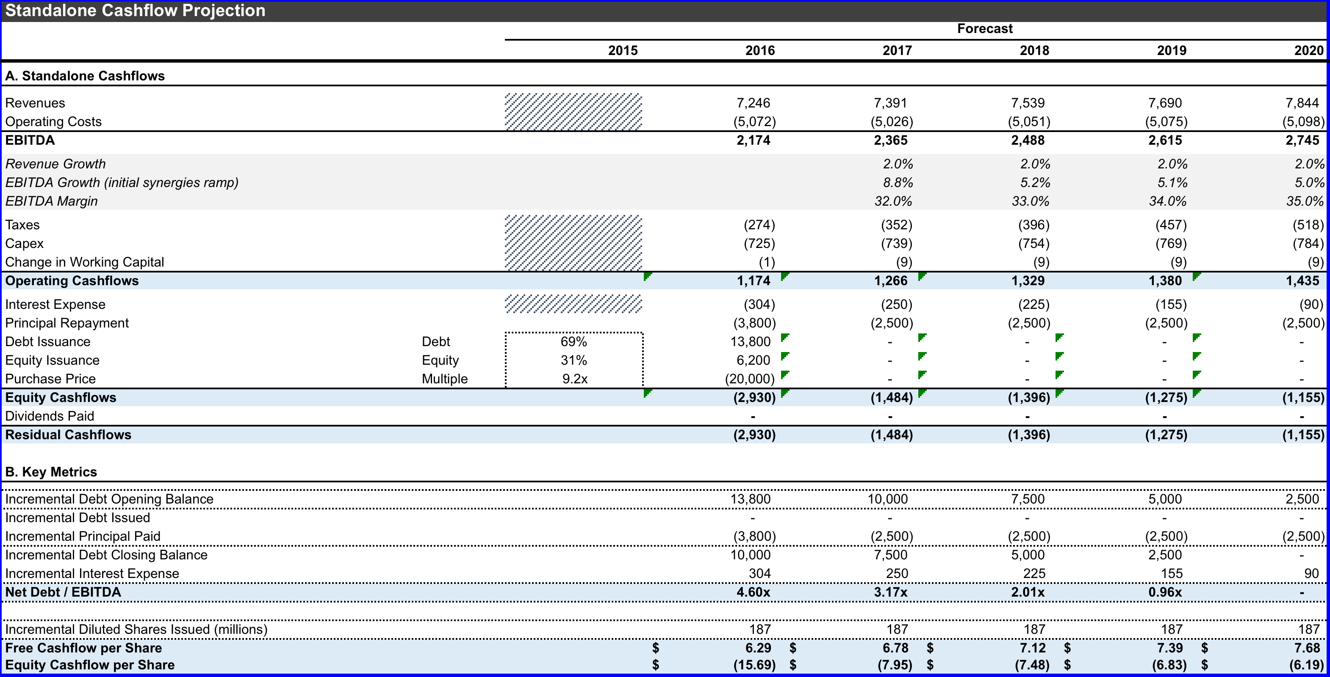
Notes:
Levered Finance – Standalone Cashflow Projections

Slide 38
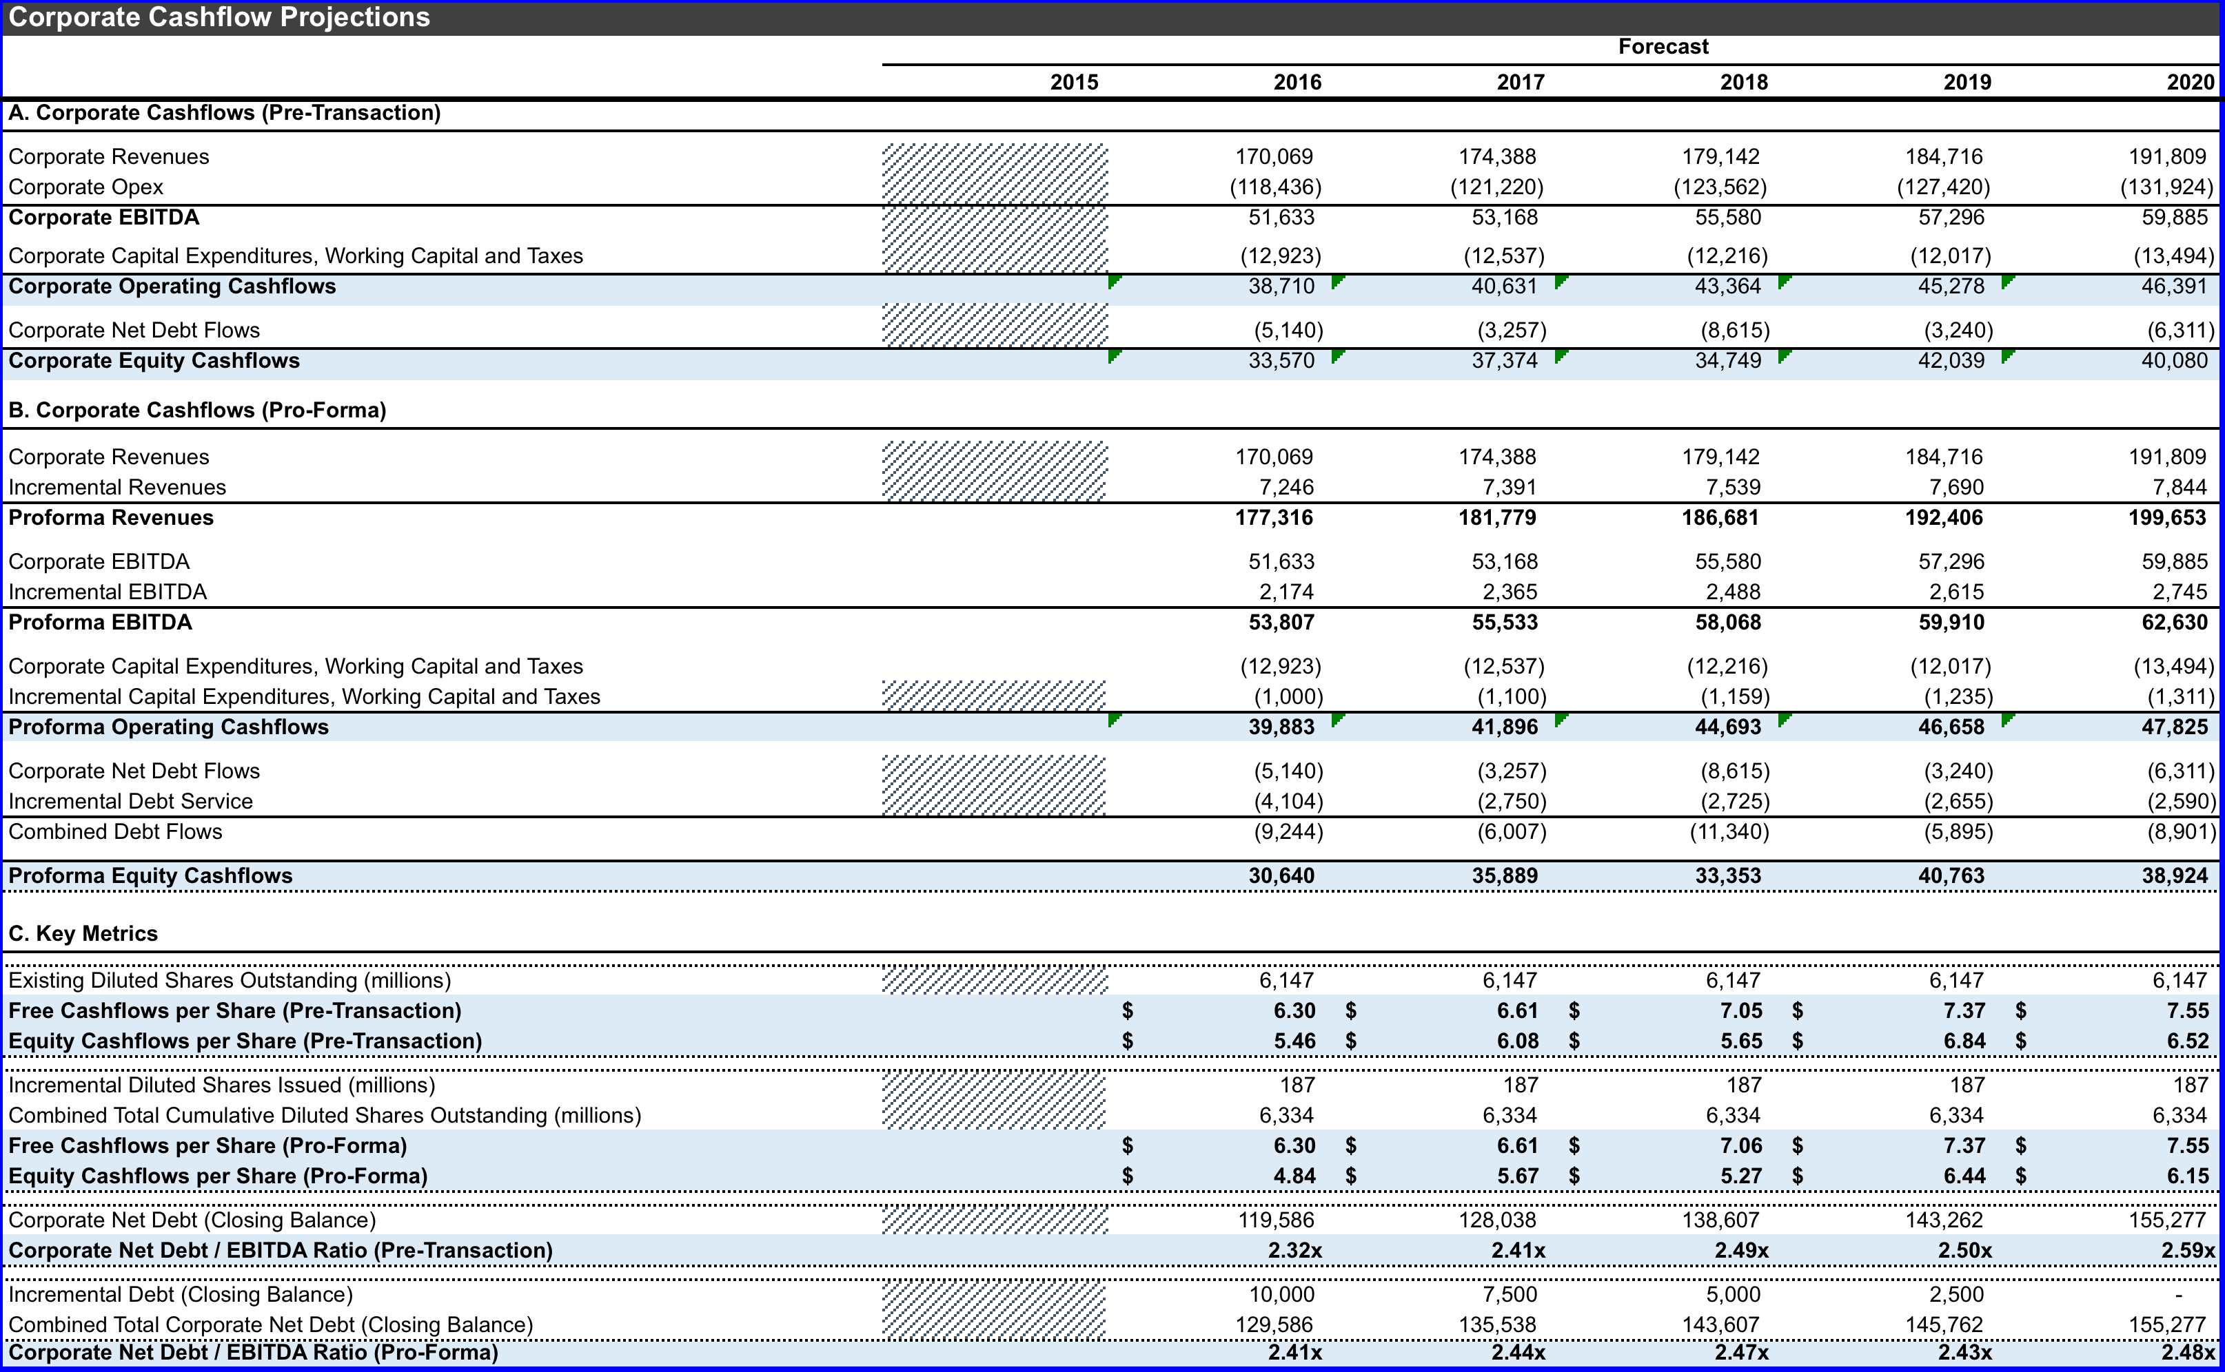
Notes:
Levered Finance – Corporate Cashflow Projections

Slide 39
Trading Comparables
Notes:
Insert all Model Output Slides.

Slide 40
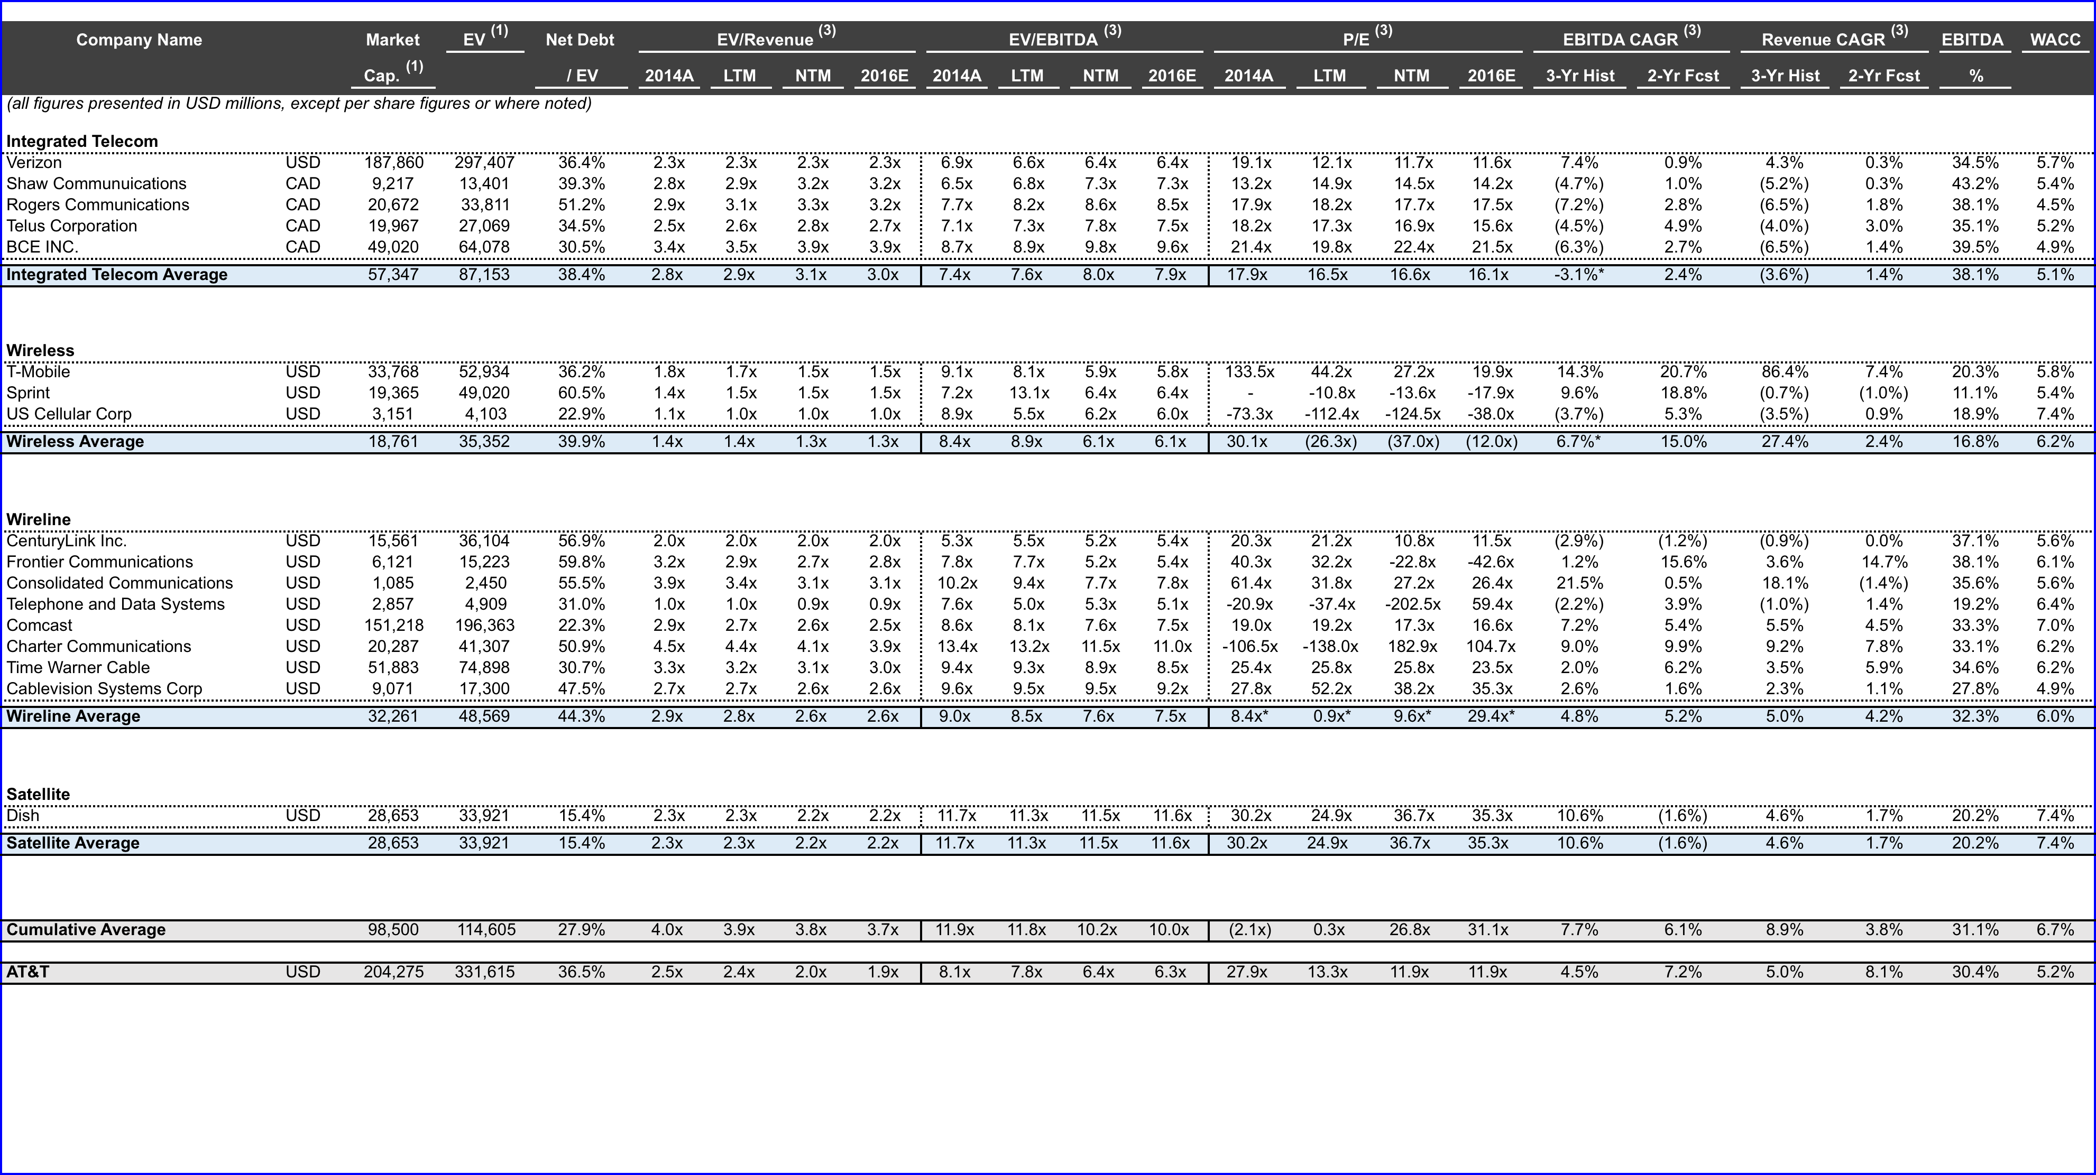
Notes:
Comparables Dataset – Trading Comparables.

Slide 41
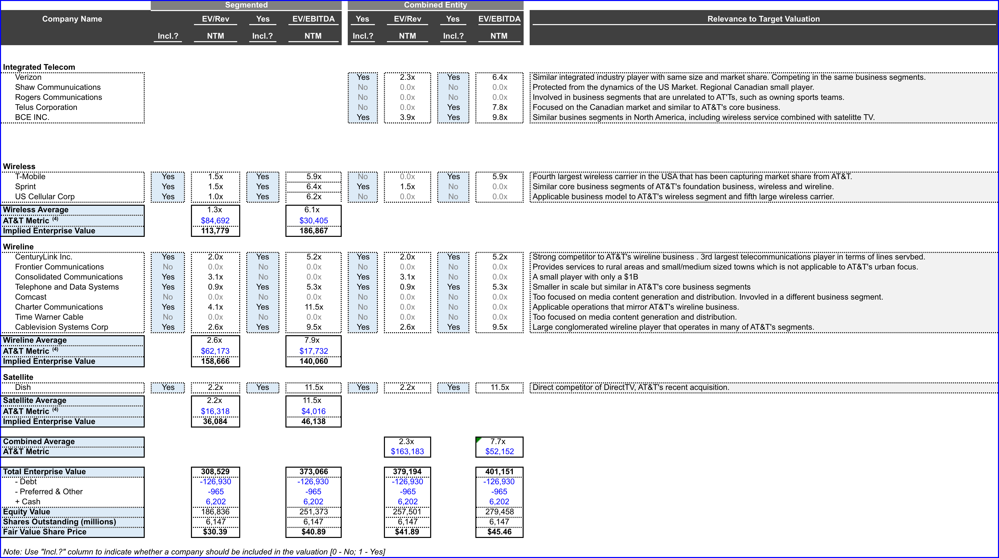
Notes:
Comparables - Valuation

Slide 42
Precedents
Notes:
Insert all Model Output Slides.

Slide 43
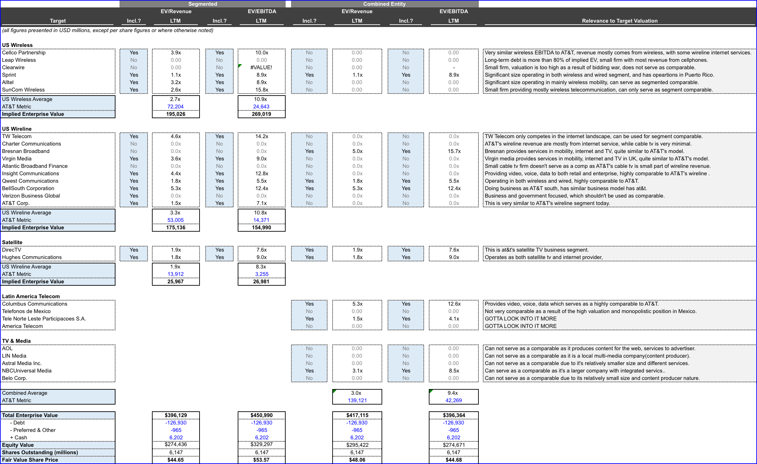
Notes:
Precedents – Valuation

Slide 44
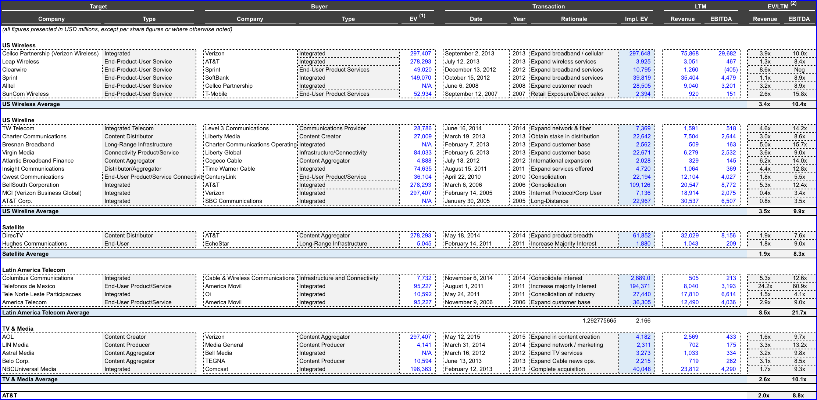
Notes:
Precedents - Dataset

